Slide 1
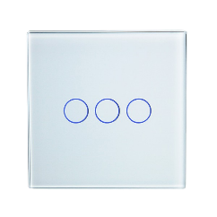
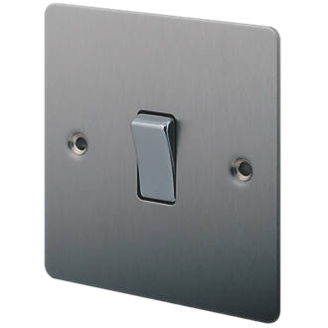
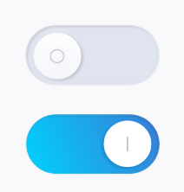
model
saref:LightSwitch
rdf:type
urn:dev:ops:32473-WoTLamp-1234
td:hasInteractionAffordance
status
toggle
overheating
…
…
…
model
…
…
…
model
TD Serialization
TD
Thing

Slide 2
Thing
Behavior
Interaction Affordances
Data Schema
WoT Thing Description
Security Configuration
Protocol Binding(s)

